Slide 1


Build a Database from a Relational Model
Your Instructor: Judy Richardson

Slide 2
Task 1: The Relational Model
Build a Database from a Relational Model

Slide 3
Steps in Database Design:
Requirements Analysis
Entity Relationship Diagram (ERD)
Relational Model

Slide 4
Data Modeling:
One-to-many relationships require a common column.
Often a primary key in one table matches the foreign key in another table

Slide 5
Data Modeling:
Many-to-many relationships require a bridge table.
Sometimes called an Intersection Table

Slide 6
The Blueprint:
Relational Model is the blueprint for creating the database using a DBMS
MySQL Workbench
SQL Server
Oracle
*** SQLiteStudio

Slide 7
Task 2: Build a Table with a GUI
Build a Database from a Relational Model

Slide 8
Naming Conventions:
Using meaningful field names, and consistent patterns in table and field names makes it easier:
To identify which table a field is in
To code multiple-table queries in SQL
To read and interpret queries

Slide 9
Customer Fields:
CustFName char 25 (check “not null”)
CustBalDue decimal 8 2 (dec. places)

Slide 10
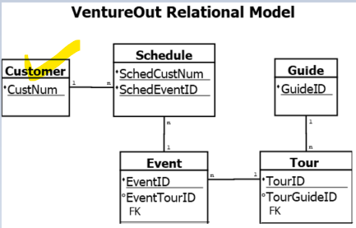
One down…four to go!

Slide 11
Guide Fields:
GuideID char 3 (check the “primary key”)
GuideLName char 25 (check “not null”)
GuideFName char 25 (check “not null”)
GuideHireDate date
GuideExpLevel integer

Slide 12
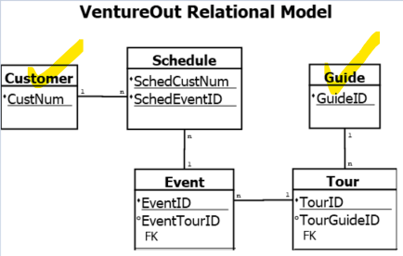
Two down…three to go!

Slide 13
Task 3: Build a Table with SQL Code
Build a Database from a Relational Model

Slide 14
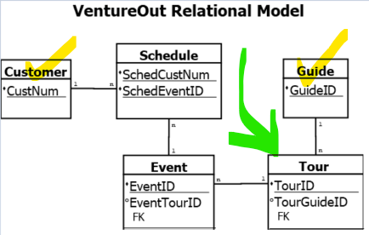
Tour Table

Slide 15
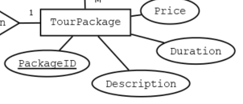
Tour Table Attributes

Slide 16
Tour Table SQL code
create table Tour
(TourID char(4) primary key,
TourPrice decimal(8,2),
TourDuration decimal(6,2),
TourDescription varchar(240),
TourGuideID char(3),
foreign key (TourGuideID) references Guide(GuideID))

Slide 17
New Stuff!
TourDescription varchar(240),
Variable character field only reserves storage space in the database if it needs it.
Char(240) reserves 240 bytes no matter what data is entered in.

Slide 18
New Stuff!
foreign key (TourGuideID) references Guide(GuideID))

Slide 19
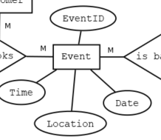

The Event Table

Slide 20
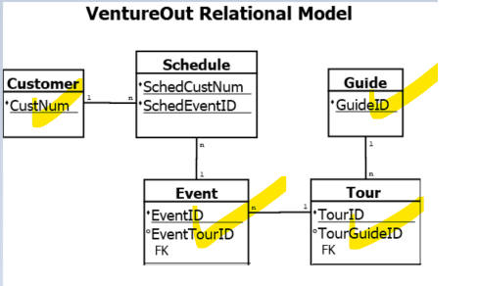
Four down…one to go!

Slide 21
Task 4: The Combination Key
Build a Database from a Relational Model

Slide 22
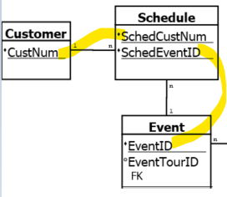
Primary Keys’ Data Types must Match

Slide 23
Keys Data Types must Match
Custnum integer
EventID integer

Slide 24
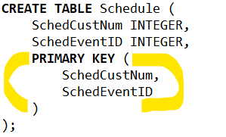
SQL Code for Combination Key

Slide 25
Task 5: Test Data
Build a Database from a Relational Model

Slide 26
Test Data
Typically not “live” data
Could be:
a subset of real data – possibly scrambled
fictional data

Slide 27
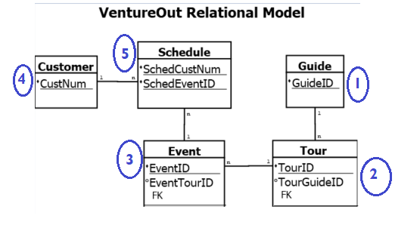
Order is important

Slide 28



Test Data – Last three tables
Event table
Customer table
Schedule table
Customer

Slide 29
Task 6: Test the Database Design
Build a Database from a Relational Model

Slide 30
The Test Plan
Purpose: to prove the database will satisfy user requirements
Begin planning for testing during Requirements Analysis phase
The more complex the data and applications – the more detailed the test plan

Slide 31
Queries for Testing
Which customers are signed up for each event?
Which guides are signed up to lead each event?
Produce a list of customer names, tour descriptions, the date they’re attending, and the name of the tour guide.

Slide 32
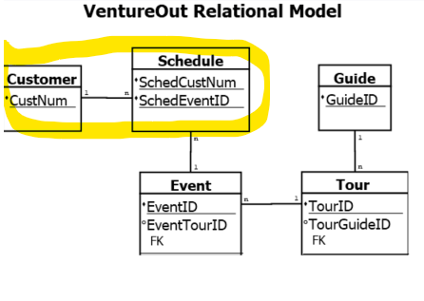
Query 1 for Testing
Which customers are signed up for each event?
Customer
Schedule

Slide 33
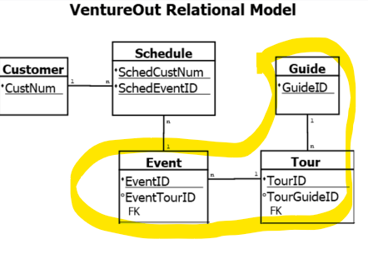
Query 2 for Testing
Which guides are signed up to lead each event?
Guide
Tour
Event

Slide 34
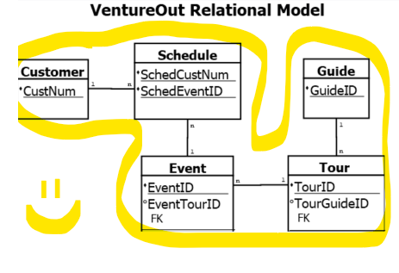
Query 3 for Testing
Produce a list of customer names, tour descriptions, the date they’re attending, and the name of the tour guide.
All tables required!

Slide 35

Congratulations on completing
Build a Database from a Relational Model

